Slide 1
Electric Current & resistance
Matt Bryant
Visiting instructor
Kent State University

Slide 2
Essential Questions
What causes electric current?
What’s moving in electric current?
How fast do the charges move in a wire?
What impedes electric current?
What laws and relationships govern electric current?

Slide 3
How can we detect the flow of charge?

Slide 4
How can we detect the flow of charge?
Two ways mentioned in your reading were heat and magnetic effects (as detected by a compass needle).

Slide 5
What is it that’s “flowing” in electric current?
It depends on the materials…
In a liquid solution positive and negative ions can both move, but in a solid metal wire, it’s the electrons that move.

Slide 6
What is it that’s “flowing” in electric current?
It depends on the materials…
In a liquid solution positive and negative ions can both move, but in a solid metal wire, it’s the electrons that move.
Which electrons?

Slide 7
What is it that’s “flowing” in electric current?
It depends on the materials…
In a liquid solution positive and negative ions can both move, but in a solid metal wire, it’s the electrons that move.
Which electrons?
Why can’t the positive protons move?
http://www.edinformatics.com/math_science/why_metals_conduct.htm

Slide 8
What is it that’s “flowing” in electric current?
It depends on the materials…
In a liquid solution positive and negative ions can both move, but in a solid metal wire, it’s the electrons that move.
Which electrons?
Why can’t the positive protons move?
They’re tightly bound in the nucleus

Slide 9
So…
…if electrons are the charge carriers in metal wires, how do we get them to move in a certain direction?

Slide 10
The Answer of course is…

Slide 11
The Answer of course is…
…we have to push them!

Slide 12
The Answer of course is…
…we have to push them!
You remember the relationship between force, charge, and field?
$\vec{F}=q\vec{E}$
And of course if the charge q is the charge of an electron e…
$F=eE$
So, we need to establish an electric field in the wire…

Slide 13
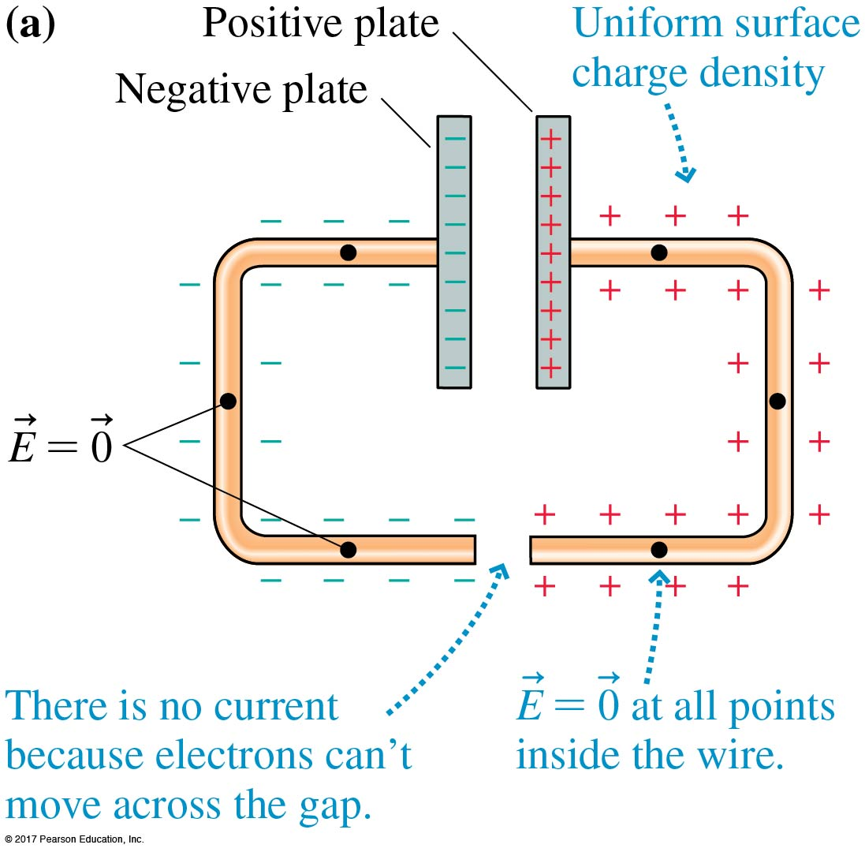
The figure shows two metal wires attached to the plates of a charged capacitor.
This is an electrostatic situation.
What will happen if we connect the bottom ends of the wires together?

Slide 14
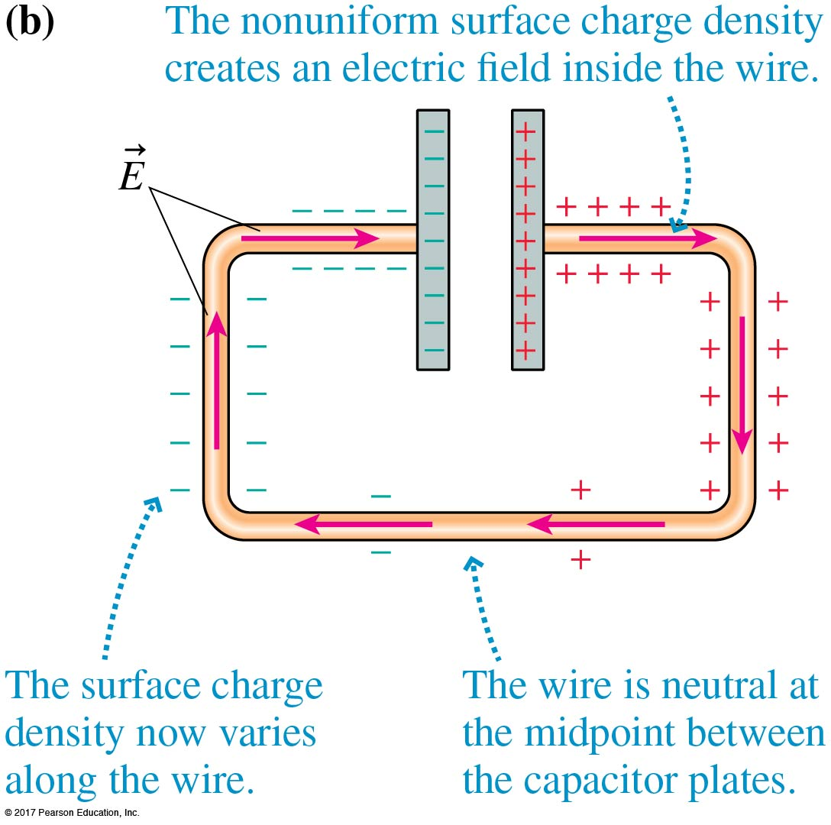
Within a very brief interval of time (≈10^{–9} s) of connecting the wires, the sea of electrons shifts slightly.
The surface charge is rearranged into a nonuniform distribution, as shown in the figure.

Slide 15
Establishing an electric Field in a wire
The nonuniform distribution of surface charges along a wire creates a net electric field inside the wire that points from the more positive end toward the more negative end of the wire. This is the internal electric field that pushes the electron current through the wire.

Slide 16
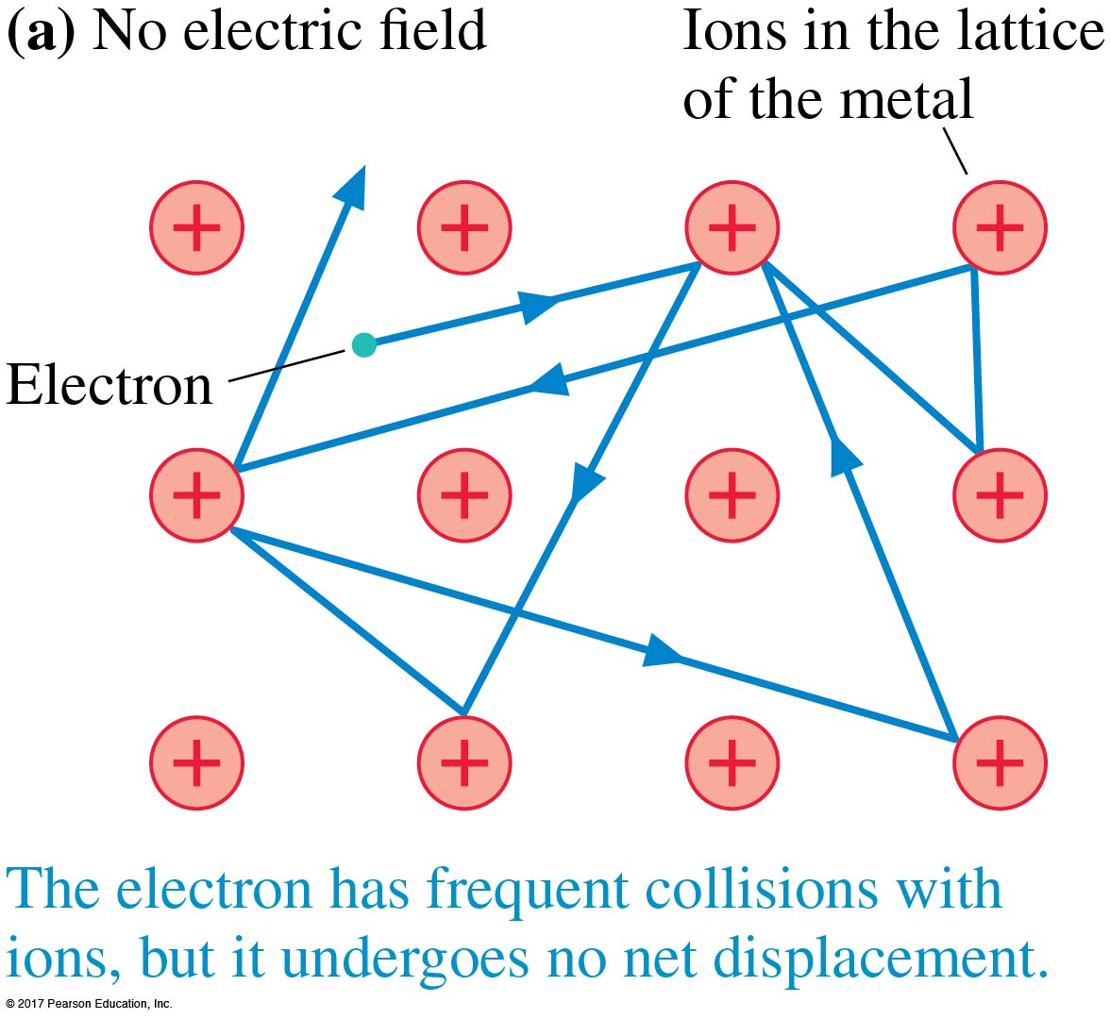
So…
…electrons are the charge carriers and they get pushed by an electric field.
How fast do those little guys move?
Well, even without an external electric field the electrons are constantly colliding with charges in the metal.

Slide 17
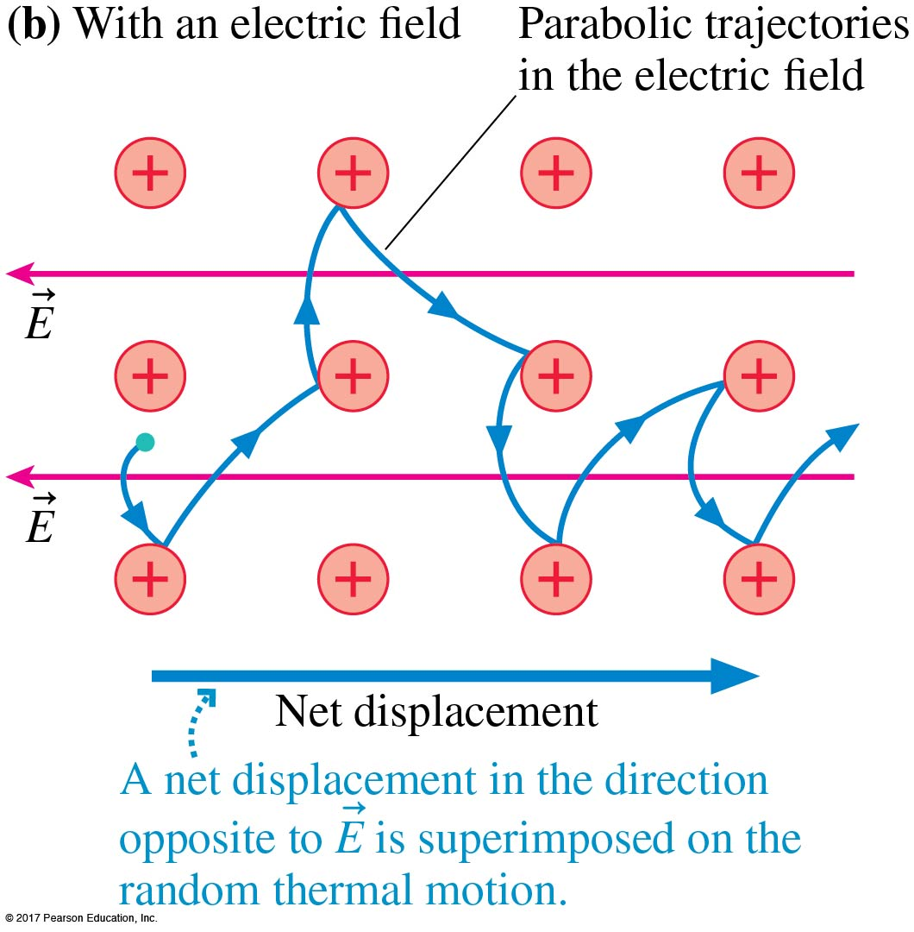
Drift Speed
Notice the field E pointing left and the electrons net displacement is right.
Because of collisions, the net drift speed of electrons to the right is limited.

Slide 18
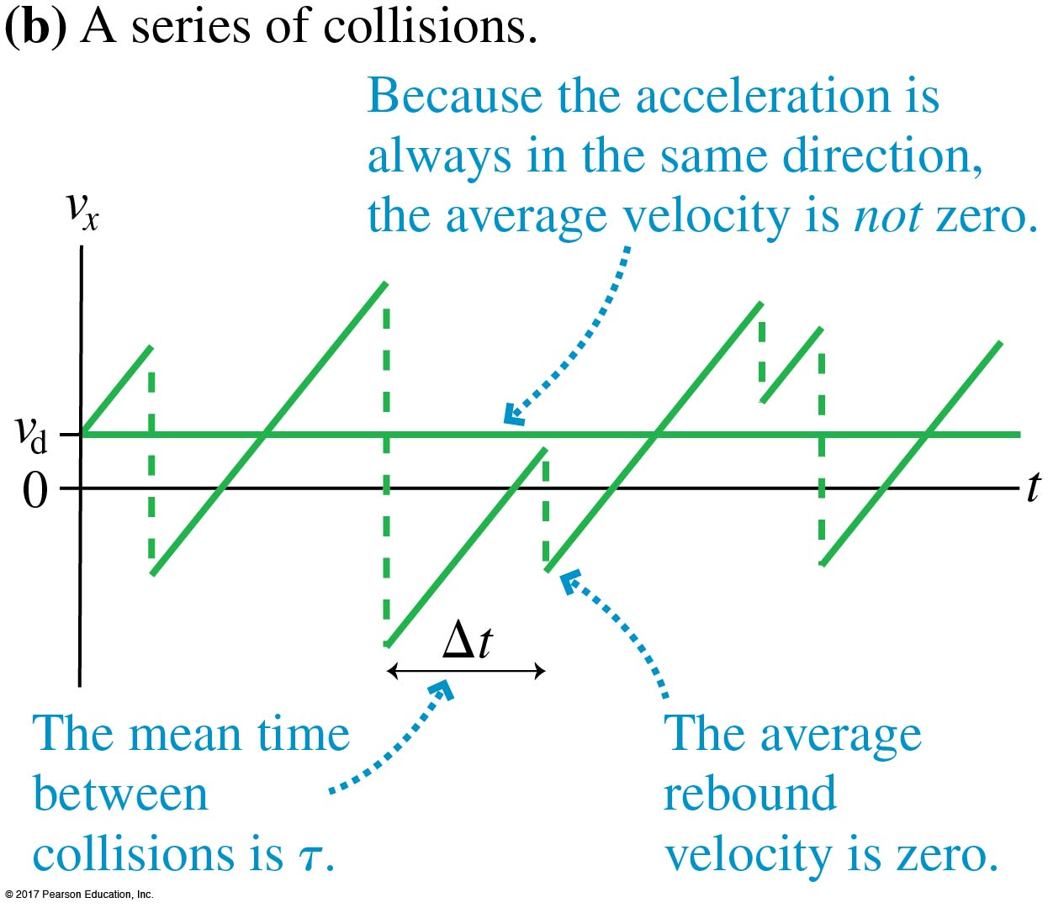
Drift Speed
Drift speed depends on a number of things including the electric field strength and properties of the particular metal…you read about those in your text.
PhET Simulation of Current in a Wire…

Slide 19
Drift Speed
Drift speed depends on a number of things including the electric field strength and properties of the particular metal…you read about those in your text.
Perhaps surprisingly, A typical drift speed of electron current through a wire is v_{d} ≈ 10^{–4} m/s!

Slide 20
Wait a minute….
With drift speeds that slow, it would take minutes for an electron to get from a battery to a lightbulb, but when we close the switch the bulb lights with almost no delay! Why?!
http://capeing.com/lighting/how-to-make-a-circuit-with-a-light-bulb-and-battery-and-switch.php

Slide 21
Wait a minute….
The entire “sea” of electrons in the wire and bulb filament start moving at basically the same time.
It’s as if the electrons are a long line of cars at a stoplight. When it turns green, they all start moving forward nearly at once! (including those in the lightbulb)
http://capeing.com/lighting/how-to-make-a-circuit-with-a-light-bulb-and-battery-and-switch.php

Slide 22
Currents
Electron Current
Charge Current
$\begin{aligned} i_{e}=\frac{N_{e}}{∆t} (that is: \#\frac{\# electrons}{time})\end{aligned}$
$i_{e}=n_{e}Av_{d}$
$\left(that is: electron density∗Area∗drift speed\right)$

Slide 23
Currents
Electron Current
Charge Current
$\begin{aligned} i_{e}=\frac{N_{e}}{∆t} (that is: \#\frac{\# electrons}{time})\end{aligned}$
$i_{e}=n_{e}Av_{d}$
$\left(that is: electron density∗Area∗drift speed\right)$
$I=ei_{e}$
$(that is: elementary charge ∗electron current)$
$I= \frac{Q}{∆t}$
Coulombs/second = Amperes (A)

Slide 24
Current Density
Current density, J, is defined as the current per square meter of cross section:
$J= \frac{I}{A}$
In Amperes per square meter (A/m²)
More on this later…

Slide 25
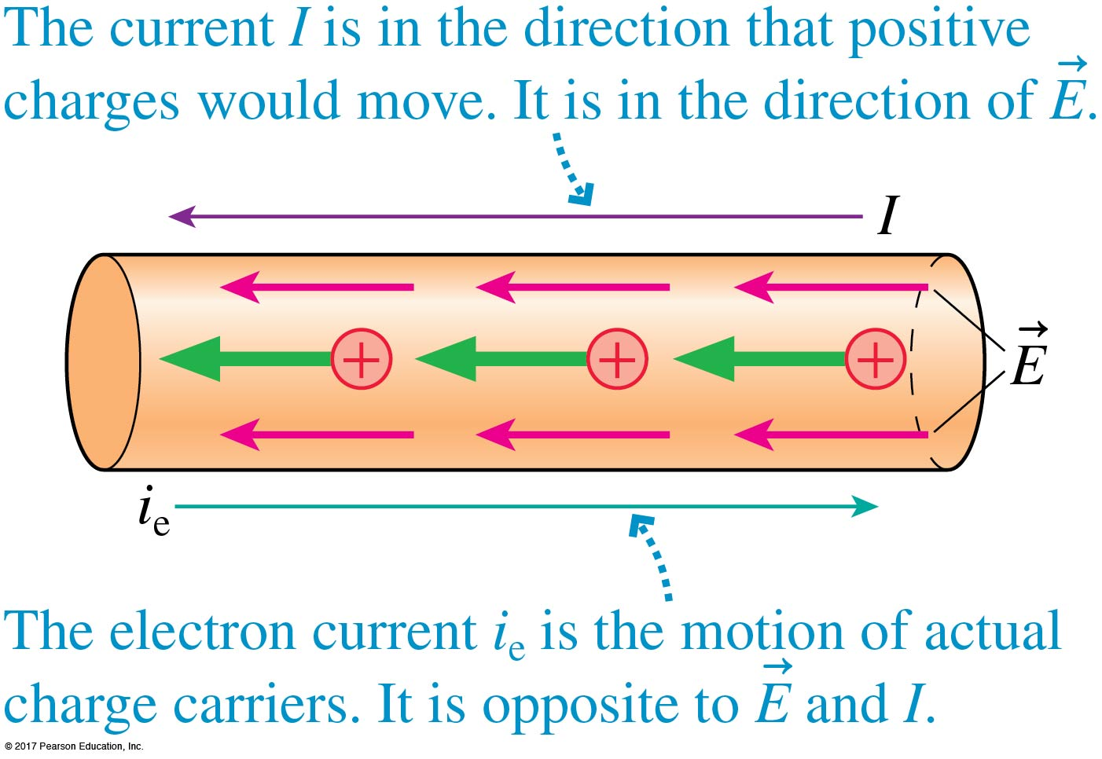
Direction of Conventional Current
Because of historical reasons, conventional (charge) current, I, is defined to be the direction of the movement of positive charges.

Slide 26
Direction of Conventional Current
Because of historical reasons, conventional (charge) current, I, is defined to be the direction of the movement of positive charges.
It is, of course, the opposite of the direction of the electrons in a wire.
Umm…Sorry?

Slide 27
A and B are identical lightbulbs connected to a battery as shown. Which is brighter?
Bulb A
Bulb B
Both Equally Bright

Slide 29
A and B are identical lightbulbs connected to a battery as shown. Which is brighter?
Bulb A
Bulb B
Both Equally Bright
If Current is the same (doesn’t get “used up”), what does change about the current?

Slide 30
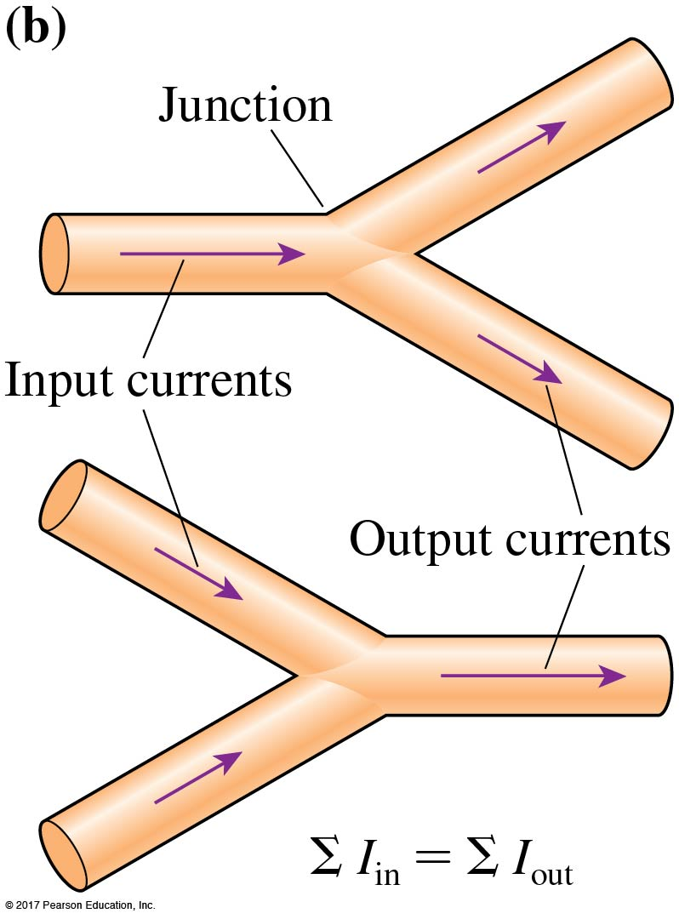
Conservation of Current
The current is the same at all points in a current carrying wire.
Also known as the Junction Rule or Kirchhoff’s Junction Rule:
$\sum{I_{in}=\sum{I_{out}}}$

Slide 32
A wire carries a current. If both the wire diameter and the electron drift speed are doubled, the electron current increases by a factor of
2
4
6
8

Slide 34
Surface charge is distributed on a wire as shown. Electrons in the wire
Drift to the right
Drift to the left
On average stay at rest
Pick a different one!

Slide 36
Every minute, 120 C of charge flow through this cross section of the wire.
The wire’s current is
240 A
120 A
60 A
2 A

Slide 38
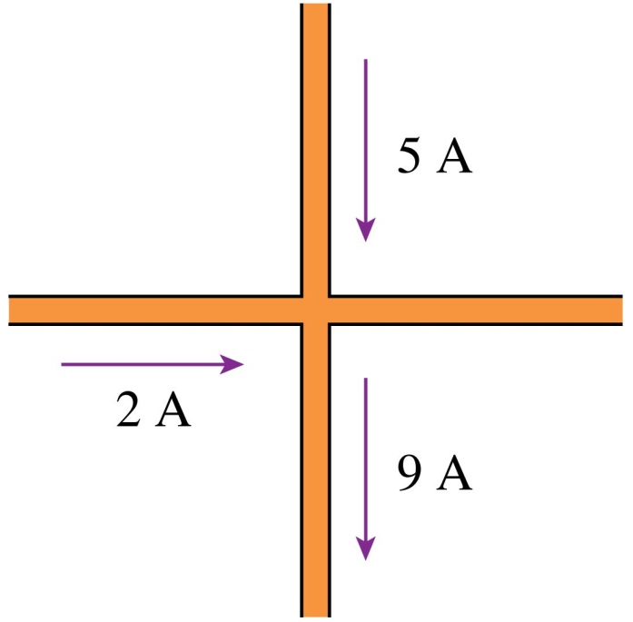
The current in the fourth wire is
16 A to the right
4 A to the left
2 A to the right
2 A to the left

Slide 40
Both segments of the wire are made of the same metal. Current I₁ flows into segment 1 from the left. How does current I₁ in segment 1 compare to current I₂ in segment 2?
I₁ > I₂
I₁ = I₂
I₁ < I₂
Not enough information

Slide 42
Both segments of the wire are made of the same metal. Current I₁ flows into segment 1 from the left. How does current density J₁ in segment 1 compare to current density J₂ in segment 2?
J₁ > J₂
J₁ = J₂
J₁ < J₂
Not enough information

