Slide 1
Quantum Theory
An introduction

Slide 2
(Somebody ask me) What is Light?

Slide 3
What is Light?
So glad you asked…
For a long time there was a debate about whether light was a particle or a wave.
Let’s watch this Veritasium video on Thomas Young’s Double Slit Experiment…
https://youtu.be/Iuv6hY6zsd0

Slide 4
Light also exhibits
Diffraction (bending of a wave around an obstacle)
Interference (waves interfere and can either reinforce each other or cancel each other)
Polarization (waves vibrating in a particular direction can make it through)
Refraction (waves change speed and direction when entering a new material--as in a prism)
All properties of waves!

Slide 5
Blackbody Radiation & Max Planck
Viewing Guide for Easy Explanation of Quantum Theory
https://youtu.be/S-4Yu3pB_dk?t=1m8s
1:10-13:00

Slide 6
Blackbody Radiation & Max Planck
Viewing Guide for Easy Explanation of Quantum Theory
https://youtu.be/S-4Yu3pB_dk?t=1m8s
https://youtu.be/0pxehdI-GYk
1:10-13:00
So Planck assumed light came in small discrete packets of energy called quanta and this explained the frequencies of light emitted by a blackbody better than the wave description.
Why did people not easily accept his explanation?

Slide 7
Photoelectric Effect & Albert Einstein
Another mystery at the time was the behavior of electrons…which were discovered by JJ Thomson in 1897.
Demonstration of photoelectric effect:
https://youtu.be/WO38qVDGgqw
The question was, why does the light have to be at a minimum threshold frequency to liberate the electrons? Why can’t a super intense beam of lower frequency do the job?
PhET Simulation of the photoelectric effect...
https://phet.colorado.edu/en/simulation/photoelectric

Slide 8
Photoelectric Effect & Albert Einstein
The question was, why does the light have to be at a minimum threshold frequency to liberate the electrons? Why can’t a super intense beam of lower frequency do the job?
PhET Simulation of the photoelectric effect...
https://phet.colorado.edu/en/simulation/photoelectric
In 1905, Einstein’s solution was that light came in discrete packets of energy (quanta or photons) and if the photon wasn’t of the right energy, it was rejected by the electrons. His explanation won him the Nobel Prize in 1921.

Slide 9
Light Scattering off Electrons & Arthur Compton
Arthur Compton’s 1923 paper contained further evidence that light behaved as a particle with momentum!
High energy (frequency) light hits an electron and gives up some of its energy and momentum to the electron and leaves at a lower energy and momentum.
http://hyperphysics.phy-astr.gsu.edu/hbase/quantum/comptint.html

Slide 10
What does it mean to be Quantized?
Like at the ATM machine…
You can often only request money in multiples of $10 or $20…so you can request $40, but you won’t have any luck requesting $35.
In the same way, light seems to be quantized in multiples of h (Planck’s Constant).

Slide 11
What does it mean to be Quantized?
Like at the ATM machine…
You can often only request money in multiples of $10 or $20…so you can request $40, but you won’t have any luck requesting $35.
In the same way, light seems to be quantized in multiples of h (Planck’s Constant).
Or imagine paying for candy as a kid…
You can pay for you candy in coins from your piggy bank, but your money is quantized.
You simply can’t pay the clerk 1.27 cents, because the smallest quanta of coin is the penny (1 cent).
So either you pay 1 cent or 2 cents, but never 1.27 cents.

Slide 12
Evidence
Wave evidence
Particle evidence
Diffraction
Polarization
Refraction (and dispersion in a prism)
Interference
Blackbody radiation (Planck)
Photoelectric Effect (Einstein)
Momentum & Energy in scattering collisions (Compton)

Slide 13
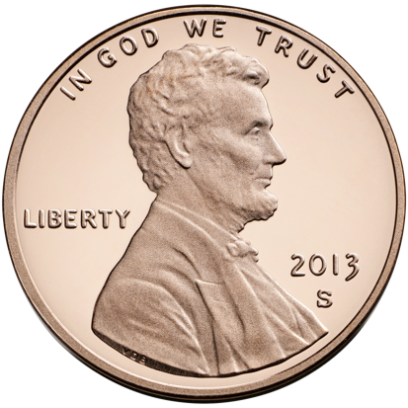
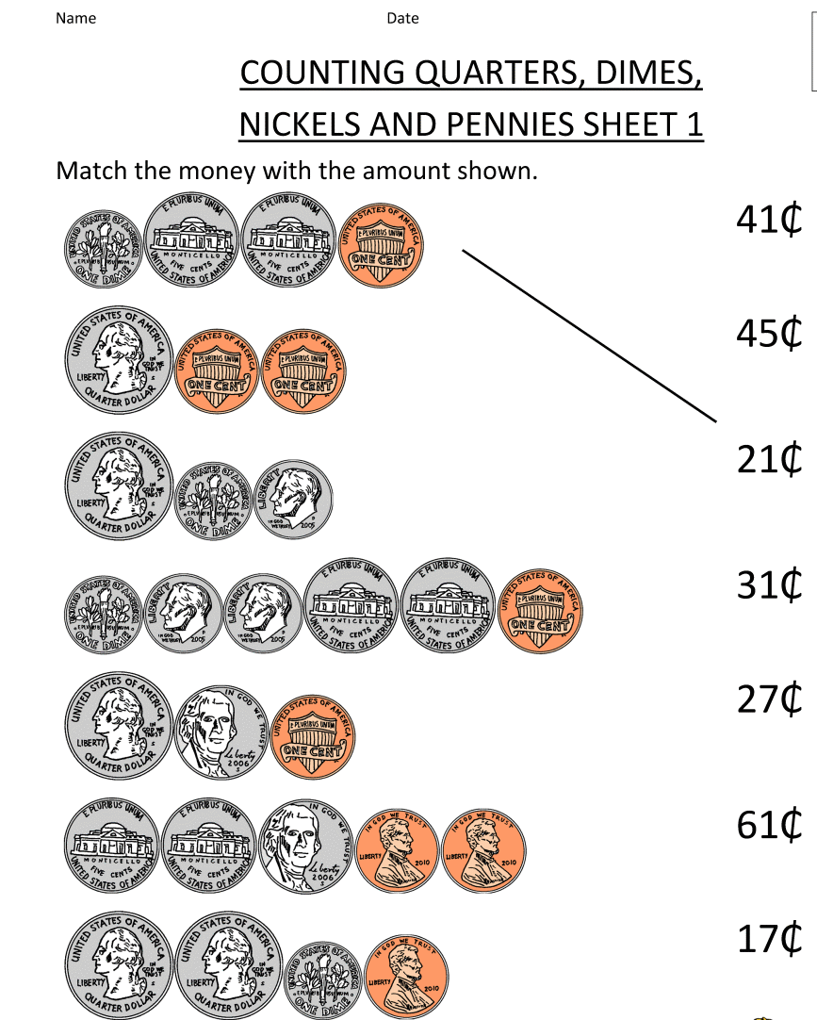
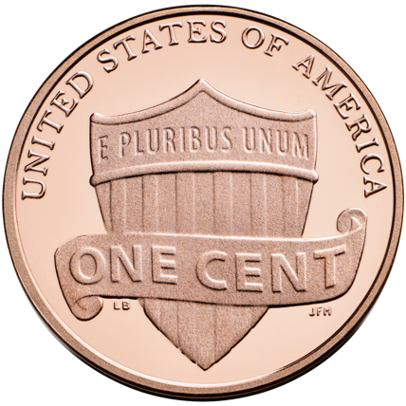
So, wave or particle?
Imagine you’ve never actually seen or held a US penny, but you’ve learned how to count money with a worksheet like the one on the left…
What might you conclude about the penny?
https://en.wikipedia.org/wiki/Penny_(United_States_coin)
http://www.math-salamanders.com/money-worksheets-for-kids.html

Slide 14
So, wave or particle?
What might you conclude about the penny?
You might conclude pennies come in two varieties…one with a portrait and one with a shield.
Imagine your surprise when you learned they were two sides of the same thing!
https://en.wikipedia.org/wiki/Penny_(United_States_coin)

Slide 15
So, wave or particle?
So is light a wave or a particle?
Yes!
It’s both!
https://en.wikipedia.org/wiki/Penny_(United_States_coin)

Slide 16
End of Day 1

Slide 17
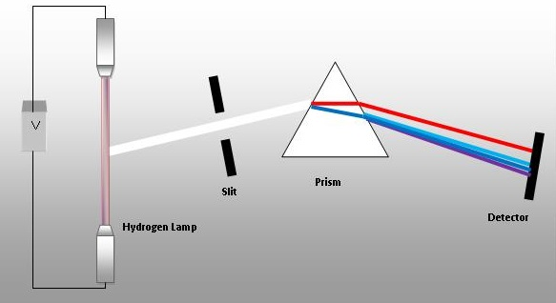
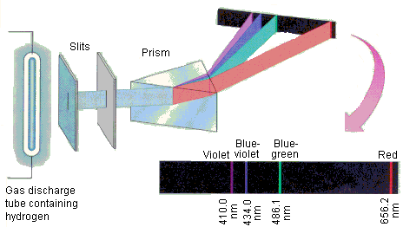
Meanwhile, others were puzzled by Spectra
When scientists excited different gases, they noticed that they didn’t get a continuous spectrum like that from an incandescent lightbulb, they instead got groups of distinct colors.
Why only certain colors?
Why were they different for different elements?
https://chem.libretexts.org/Core/Physical_and_Theoretical_Chemistry/Quantum_Mechanics/09._The_Hydrogen_Atom/Atomic_Theory/Electrons_in_Atoms/Atomic_Spectra

Slide 18
Meanwhile, others were puzzled by Spectra
Why only certain colors?
Why were they different for different elements?
Demonstration…with spectrum tubes…
https://chem.libretexts.org/Core/Physical_and_Theoretical_Chemistry/Quantum_Mechanics/09._The_Hydrogen_Atom/Atomic_Theory/Electrons_in_Atoms/Atomic_Spectra

Slide 19
Amazing story of light
See handout…
But why only those specific colors (or frequencies or wavelengths)?

Slide 20
Hydrogen Spectra & Niels Bohr
In 1913, Bohr proposed a quantized shell model of the atom. Electrons “inhabited” certain energy shells according to their energy.
The kicker was, that only certain energies were “allowed.”
Demo with Slinky…

Slide 21
Hydrogen Spectra & Niels Bohr
In 1913, Bohr proposed a quantized shell model of the atom. Electrons “inhabited” certain energy shells according to their energy.
The kicker was, that only certain energies were “allowed.”
http://physics.gmu.edu/~dmaria/590%20Web%20Page/public_html/qm_topics/potential/well/ParticleInABox.htm
Furthermore, Bohr, working with the simplest element hydrogen, could calculate the specific wavelengths of light that the hydrogen atom emitted by assuming the allowed energies corresponded to the electron behaving as a wave and interfering with itself to form a standing wave!

Slide 22
The Energy of Photons and Electrons is Quantized!
The energy content of one quantum of energy is given by $E=hf$, where $f$ is the frequency of the light (its color) and $h$is the constant that relates the two variables.
Violet light is of a higher frequency, so it’s of a higher energy and is more violent!
That photon energy is the same energy difference between allowed electron shells in an atom.
https://phet.colorado.edu/en/simulation/legacy/discharge-lamps

Slide 23
So…
Electrons are big waves that circle the nucleus…
Electrons must circle the nucleus a whole number of times so that electrons will form standing waves of whole number wavelengths around—but never a fractional number of wavelengths.
All light in the universe comes from “falling” electrons!
Well, at least visible light….

Slide 24
So the electron is behaving as a wave?!
Well, some thought Bohr’s work was simply a mathematical trick that happened to work, but that electrons, which were certainly particles, were not really behaving as waves…
Then we have another hypothesis by Louis DeBroglie (1924) and electron experiments by Davisson and Germer (1927-Bell Labs).
For a summary and a bit of history, try this BBC documentary on “Uncertain Principles:”
https://youtu.be/KUyT-G8P4dA
https://youtu.be/iu6kqO4L0KQ
Stop at 26:45

Slide 25
DE Broglie Wavelengths
Louis De Broglie proposed that all matter particles behave as waves as well.
The wavelength of the particles (uhm…er waves) is
$$λ=\frac{h}{mv}$$
Which for large things like pitched baseballs turns out to be about $1×{10}^{−35}$m (much smaller than an atom at $1×{10}^{−10}$m ). This is why we don’t notice everyday objects behaving as waves.
On the other hand, even a slow moving electron on the other hand…has a much larger wavelength $1×{10}^{−4}$m

Slide 26
Heisenberg’s Uncertainty Principle
Heisenberg’s Uncertainty Principle states that you cannot know a particles position and momentum (mass and velocity) at the same time with infinite precision.
Mathematically it’s expressed as $∆x∆p≥\frac{h}{4π}$
From Veritasium: Heisenberg’s Uncertainty Principle
https://youtu.be/a8FTr2qMutA

Slide 27
Heisenberg’s Uncertainty Principle
Heisenberg’s Uncertainty Principle states that you cannot know a particles position and momentum (mass and velocity) at the same time with infinite precision.
Mathematically it’s expressed as $∆x∆p≥\frac{h}{4π}$
One way to think about why this is so is to imagine measuring or detecting one of those…let’s say you want to know precisely where an electron is, how do you determine this?
Well, you’d have to hit the electron with something….another particle or photon of light. You must have the electron interact with something else—bounce something off the electron or have the electron’s electric field interact with another electric for example…

Slide 28
Heisenberg’s Uncertainty Principle
Mathematically it’s expressed as $∆x∆p≥\frac{h}{4π}$
One way to think about why this is so is to imagine measuring or detecting one of those…let’s say you want to know precisely where an electron is, how do you determine this?
Well, you’d have to hit the electron with something….another particle or photon of light. You must have the electron interact with something else—bounce something off the electron or have the electron’s electric field interact with another electric field for example…
The act of measuring the electron’s position will change its speed and/or direction so you will lose information about its momentum!

Slide 29
Heisenberg’s Uncertainty Principle
The principle is a bit deeper than that last statement and is closely linked with calculations involving probability and Schr$\ddot{o}$dinger’s Wave Function.
What is the Heisenberg Uncertainty Principle?-Chad Orzel
https://youtu.be/TQKELOE9eY4
This result of combining wave and particle characteristics!

Slide 30
It Gets weirder…
Double Slit Experiment explained by Jim Al-Khalili
https://youtu.be/A9tKncAdlHQ
Or
Single Photon interference at Veritasium:
https://youtu.be/GzbKb59my3U

Slide 31
It Gets weirder…
Double Slit Experiment explained by Jim Al-Khalili
https://youtu.be/A9tKncAdlHQ
Oh boy…
This is perhaps one of the most confounding and puzzling things about quantum theory…
Do the electrons (or atoms, or photons) go through one slit or the other or both?
How do we explain this?!?

Slide 32
Quantum Interpretations
The Quantum Experiment That Broke Reality:
https://youtu.be/p-MNSLsjjdo?t=1m42s
About 9 minutes
And The Many Worlds of the Quantum Multiverse
https://youtu.be/dzKWfw68M5U?t=5m59s
Quantum Mechanics (an embarrassment) – Sixty Symbols
https://youtu.be/ZacggH9wB7Y

Slide 33
Two Common Interpretations
Copenhagen
Many Worlds
Heisenberg and Bohr
The Wave Function tells you the probability of finding the particle in any given place and in some sense the particle is in all the places at once.
At observation the wave function “collapses” and the particle is randomly found at one of the places that were predicted.
Hugh Everett
Particles are in one universe and then at observation the universes split and we find ourselves in one of those universes.
The particle we observe takes one path, but duplicate particles take other paths in universes in which we don’t live.

Slide 34
Summary
Light comes in tiny bundles called photons. (E=hf)
Particles behave like waves ($λ=\frac{h}{mv}$)
But we don’t often notice 1 & 2 because h is so small.
Electrons are big waves that surround the nucleus
Visible light is made from “falling” electrons
There is no such thing as a definite & precise electron (or proton, neutron, or atom)
Uncertainty or quantum weirdness is just that—weird and uncertain. There’s a bit of chance in every interaction.

