Slide 1
Einstein’s General theory of relativity
Notes to help you understand

Slide 2
Einstein’s Broadly Applicable theory of relativity
Notes to help you understand

Slide 3
A clip from The Late Show…
Brian Greene Explains That Whole General Relativity Thing (~8 minutes)
https://youtu.be/0jjFjC30-4A

Slide 4
What’s the difference?
Applies to objects moving at constant speed and direction
Speed of light is constant no matter the motion
Space and Time are relative but connected to each other
Applies to objects—even objects that are accelerating.
Gravity is indistinguishable from acceleration
Space-time is curved and this affects motion and time
Special Relativity
General Relativity

Slide 5
Einstein’s Equivalence Principle
You can’t tell the difference between gravitational acceleration and any other acceleration.
In an sealed spaceship…your weight might come from the planet’s gravity or the acceleration of the ship—you can’t tell the difference.
The Expanse: NASA Behind the Scenes-Gravity (2min 12 sec)
https://youtu.be/Js9V-dXuZUM

Slide 6
Einstein’s Gravity
http://www.pensivethoughts.com/2013/07/roll-coin-funnel-surface-at-sm-mall-of-asia.html
http://www.pensivethoughts.com/2013/07/roll-coin-funnel-surface-at-sm-mall-of-asia.html
Einstein’s Theory of General Relativity is a new take on Gravity
Einstein said that what we feel as gravity is but an illusion. It’s really just us trying to move in a ”straight” line in curved space-time!
Maybe you’ve seen those coin funnels in the mall?
http://www.pensivethoughts.com/2013/07/roll-coin-funnel-surface-at-sm-mall-of-asia.html

Slide 7
John Wheeler’s simple explanation
“Space tells matter how to move; matter tells space how to curve”
(He also coined the term “black hole!”)
Albert Einstein, Hideki Yukawa,
and John Wheeler
http://www.bigear.org/CSMO/HTML/CS04/cs04all.htm

Slide 8
How do we know it’s true?
Experimentalist vs. Theorist on Einstein’s General Theory of Relativity
https://youtu.be/LVGAKbRdKcY
Starlight is bent by the Sun’s gravity, by the amount predicted by Einstein’s theory!
Since then many other tests have shown Einstein’s theory to work.

Slide 9
The Fabric of the Cosmos
Let’s watch a clip from Brian Greene’s The Fabric of the Cosmos that details one such test…
DVD Episode “What is Space?” Chapter “The Problem with Gravity” ~17:40 to ~27:44
https://youtu.be/QL59cxglieM

Slide 10
Black Holes
Can be formed in Supernova explosion of a star.
Space-Time is so curved around the black hole that light trying to emerge from the black hole simply curves back into the hole!
The closest you can get to a Black Hole and have any hope of not getting pulled in forever is called the event horizon—an spherical boundary around the black hole that’s larger for more massive black holes.
Neil DeGrasse Tyson has a book…Death by Black Hole

Slide 11
While Black Holes don’t emit light themselves, sometimes matter falling into the hole heats up and emits light.
The first such black hole was detected via its x-ray emissions in the constellation Cygnus. It’s known as Cygnus X-1
https://www.nasa.gov/audience/forstudents/k-4/stories/nasa-knows/what-is-a-black-hole-k4.html

Slide 12
Interstellar (2014)
The movie accurately (and emotionally) depicts time slowing down near a black hole

Slide 13
The Fabric of the Cosmos
Let’s watch another clip from Brian Greene’s The Fabric of the Cosmos that describes this and the possibility of time travel…
DVD Episode “The Illusion of Time” Chapter “Time Travel & The Arrow of Time” ~30:30 to 36:40
https://youtu.be/fCAnNWqQFOQ

Slide 14
Wow!
You must have questions…I do…
Newton vs. Einstein on Gravity…handout

Slide 15
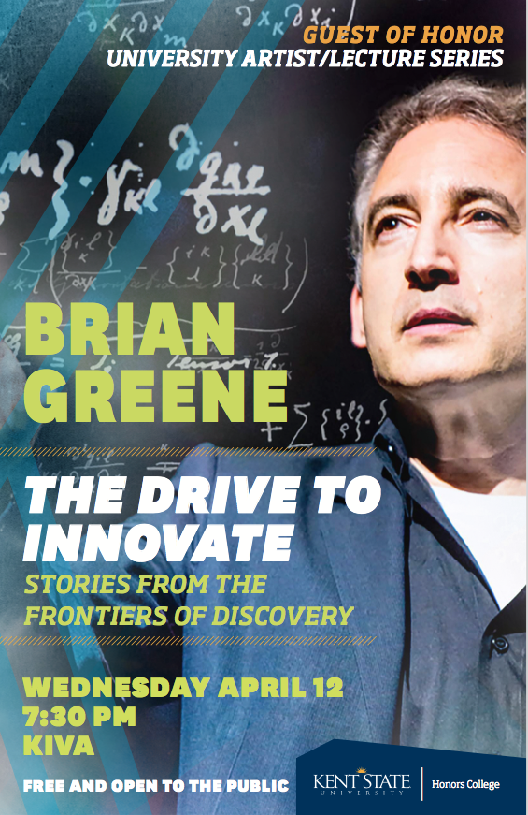
Brian Greene visits KSU Wed. Apr 12!
I’m happy to award 4 bonus points if you attend and see me after his talk.
Wednesday, April 12,
7:30pm in the Kiva

Slide 16
KSU Planetarium Shows
The Search for Extraterrestrial Intelligence
Friday, April 21, 8pm
Saturday, April 22, 8pm
Starting April 10th, you must make a reservation by visiting office 115 or calling 672-7009
4 bonus points with proof of attending.

Slide 17
The Discovery of Gravitational Waves
Gravitational Waves Hit the Late Show
https://www.youtube.com/watch?v=ajZojAwfEbs

