Slide 1
Big Bang Cosmology

Slide 2
Cosmic History
Quasars
Hubble Deep Field
Dark Ages

Slide 3
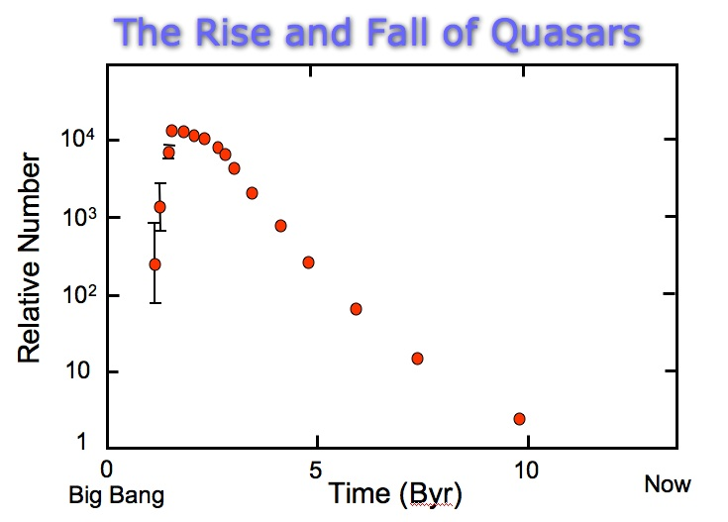
The Era of Quasars
As discussed earlier, the farther away astronomers look, the farther back in time they observe the universe.
The Era of Quasars, well-fed supermassive black holes at the centers of galaxies, came early in cosmic history.
The era ended when the abundance of available material to feed the supermassive black holes was used up.
http://people.virginia.edu/~dmw8f/astr5630/Topic14/t14_QSO_SFR_history.html

Slide 4
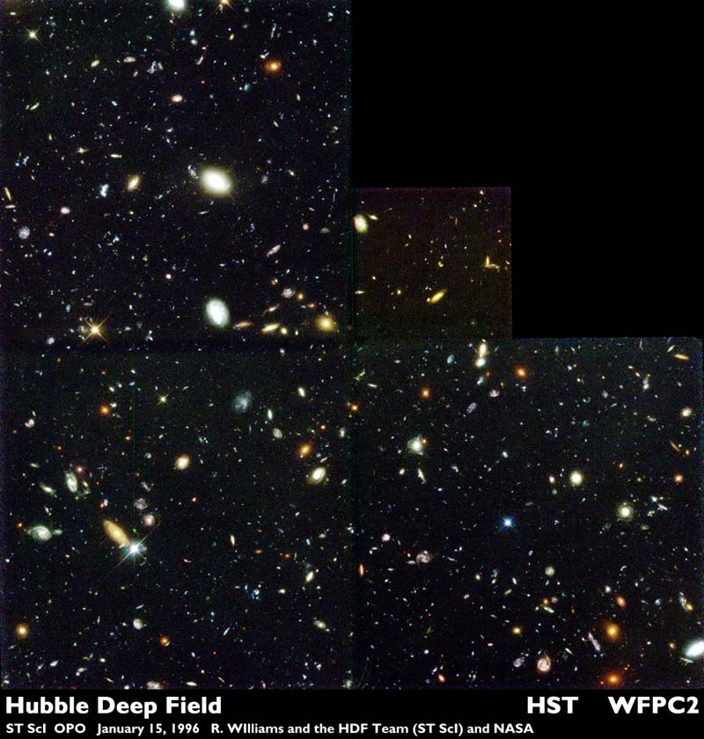
Hubble Deep Fields
1996 Hubble Deep Field, HST stared at some patch of sky for 1 entire week (>100 hours). The patch was “empty” and contained no known objects!
Later followed by 2003/2004 Ultra Deep Field and 2012 Extreme Deep Field
Reveal a myriad of galaxies far back into cosmic history including collisions and starbursts.
https://apod.nasa.gov/apod/ap980607.html

Slide 5
The Dark Ages
The Hubble Deep Fields show galaxies as far back as about 13 billion years. Remember current age estimates for the universe are about 13.7-13.8 billion years.
At about 300,000 years after the BB, hydrogen atoms formed and began absorbing visible light photons—the universe was filled with sort of a gray fog—the Dark Ages—opaque to visible and UV light.
The Dark Ages ended with the emergence of stars and galaxies where much of the neutral hydrogen gravitationally condensed.

Slide 6
Building Cosmic Structure
First Stages—Rich get Richer
Dark Matter

Slide 7
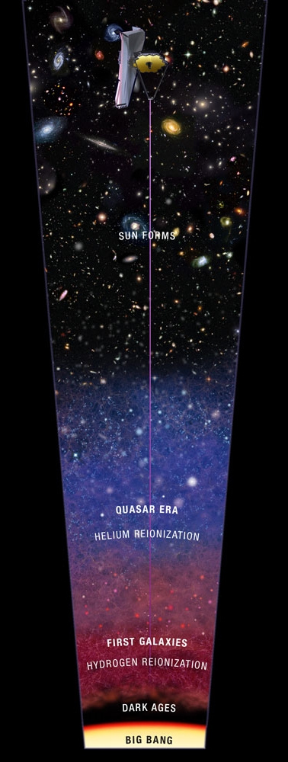
The 1st Stages: The Rich Get Richer
Density perturbations, which are small differences in mass in one place versus another, formed the seeds around which all larger structures could be created by gravity
The first stars were many times larger than stars that exist today because of the absence of heavier elements to limit their growth (100-300 solar masses)
The first black holes were the progenitors of quasars
Ionizing radiation from the first stars and black holes ended the dark ages by ionizing neutral hydrogen.
https://jwst.nasa.gov/firstlight.html

Slide 8
Dark Matter
Dark matter (now thought to make up about 87% of matter in the universe) played a fundamental role in cosmic evolution. Through simulations, astronomers have learned that dark matter was present from the beginning and is must have been “cold” or moving at non-relativistic speeds
In galactic evolution, spiral galaxies evolve into elliptical galaxies through collisions.
What about from zero to 300,000 years after the BB?

Slide 9
Competing Cosmologies

Slide 10
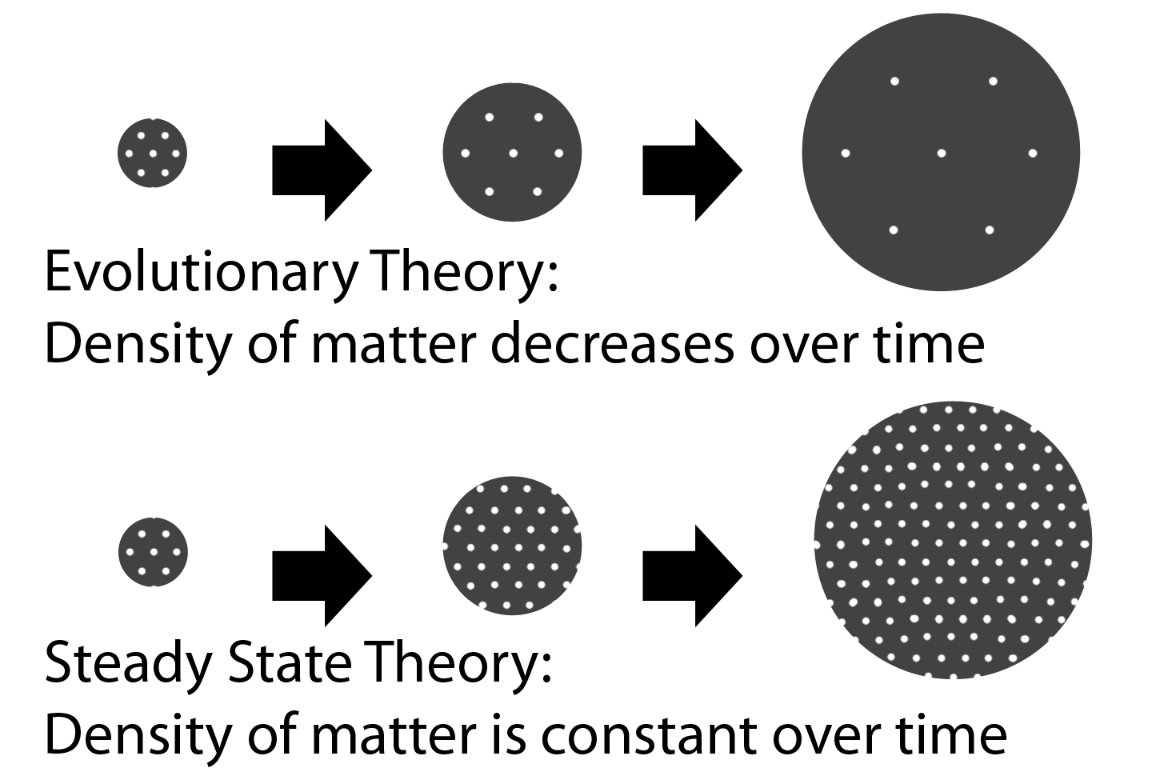
Steady State vs. Expanding Universe
Early scientific cosmological theories included Fred Hoyle’s steady-state model in which the universe did not evolve but always looked the same from one epoch to the next.
Today, the generally accepted model is the Big Bang model which describes what happened after cosmic expansion began.
https://cosmictimes.gsfc.nasa.gov/online_edition/1955Cosmic/origin.html

Slide 11
The Stage and the Actors
Space-Time
Standard Model of Particle Physics

Slide 12
The Stage and the Actors…
“The Stage” is flexible space-time as is described by Einstein’s Theory of General Relativity. The geometry of the space-time has evolutionary consequences that are detectable observationally.
“The Actors” are the members of the standard model of particle physics which encompasses our understanding of matter, energy, and forces at the fundamental level.
https://blog.higgshunters.org/2014/11/28/introduction-to-particle-physics-part-3-order-from-chaos-the-standard-model-arrives/

Slide 13
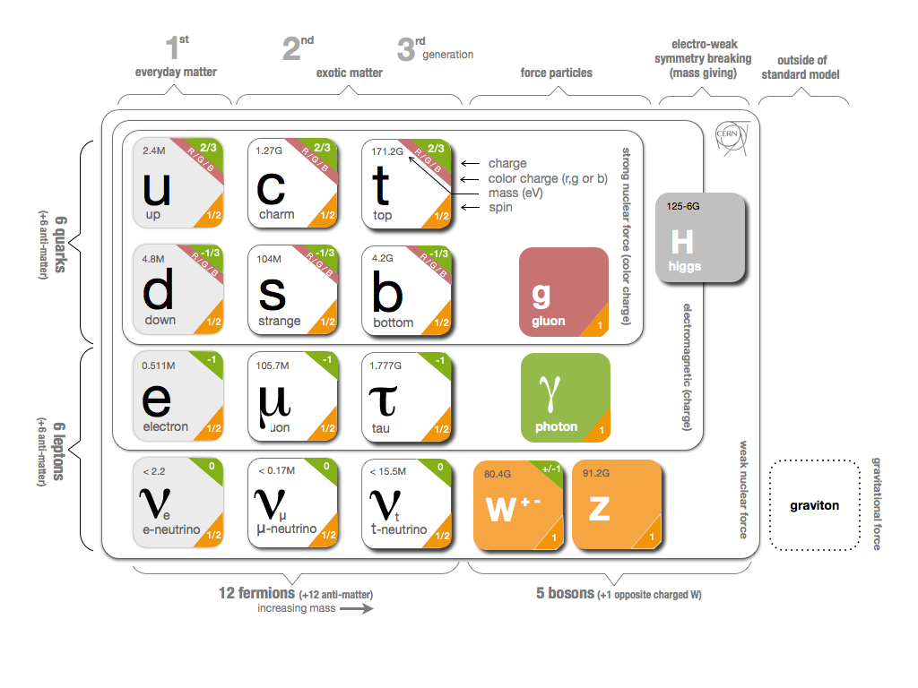
http://united-states.cern/physics/standard-model-and-beyond

Slide 14
The Story
Singularity
Inflation
Particle Era
Nucleosynthesis
Recombination

Slide 15
The Singularity ($t=0$)
Tracing cosmic history backward takes us to a cosmic singularity which implies infinite density, temperature, and space-time curvature. This state is similar to the singularity at the center of a black hole. As with black holes, a complete theory for it does not yet exist.
Physicists expect all the four fundamental forces at this stage would be unified into a single force. The biggest hurdle yet to be overcome is unifying a quantum field theory of gravity with the other three forces.

Slide 16
Inflation ($t=0 to t={10}^{−33}seconds$)
Theorists have good reasons to believe that quantum fields in this early part of the universe were in an excited state. As they relaxed the enormous released energy pushed space-time to expand at a stupendous rate.
This period is called inflation and the space is thought to have expanded by a factor of ${10}^{60}$!
Inflation ended nearly as quickly as it started and the universe continued to expand but at a much slower rate.
Remember this is an expansion of space itself—not stuff moving out into a void.

Slide 17
Particle Era ($t={10}^{−33}s to t=0.001 s$)
As the universe expanded and cooled, the matter and energy went through a series of “phase transitions” and the fundamental particles of the standard model were produced. (energy into matter)
During this particle era quarks and leptons were produced as the universe’s density dropped and the temperature decreased.
Quark soup!
One unanswered question is why the universe ended up with more matter particles than anti-matter particles…

Slide 18
Big Bang Nucleosynthesis ($t=0.001s to t=3 minutes$)
During these first 3 minutes, the light elements, including hydrogen, helium, and lithium, were first forged.
H, He, and Li nuclei were synthesized by the Big Bang , hence the name Big Bang Nucleosynthesis (BBN)
Models indicate that the abundances of the light nuclei were:
H-1, 75%
He-4, 25%
H-2, 0.0028%
He-3, 0.0015%
Li, 0.000 000 01%

Slide 19
Recombination ($t\sim 380,000 years$)
The temperature of the universe had cooled enough for electrons to bind to atomic nuclei and the first atoms formed. (Since they were never previously combined, maybe this should really be called combination.)
Previous to this, photons interacted so strongly with the free positive nuclei and electrons that the universe was opaque to all forms of EM radiation.
During Recombination, the light decoupled from matter and could travel through space without getting stopped. (Well at least some photons could, some visible and UV photons still got absorbed by hydrogen atoms.)
Cosmic Microwave Background radiation was “released.”

Slide 20
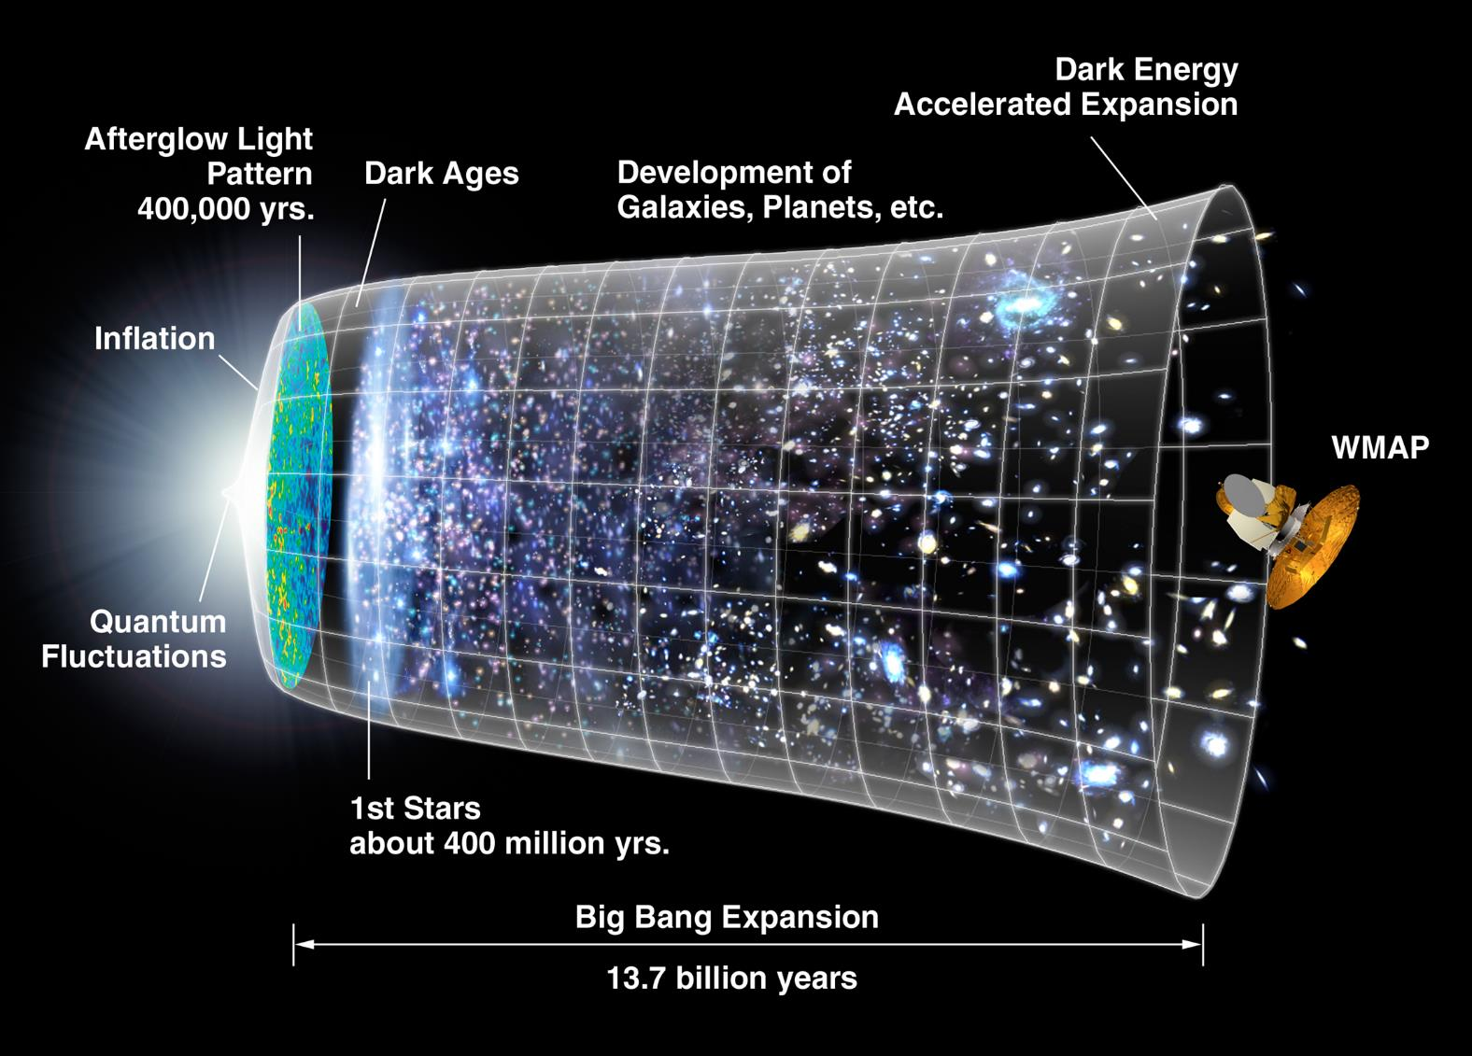
https://apod.nasa.gov/apod/ap060323.html

Slide 21
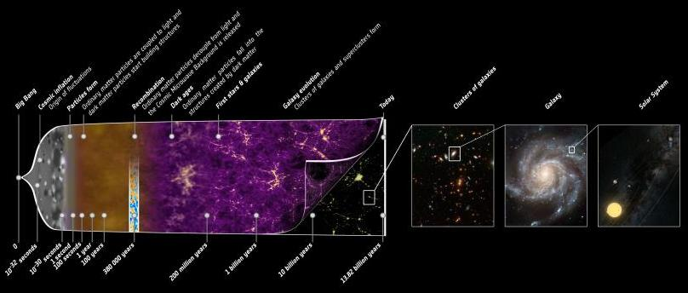
https://photojournal.jpl.nasa.gov/gallery/universe?subselect=Mission%3APlanck%3A

Slide 22
Evidence for the Big Bang
Cosmic Expansion
Big Bang Nucleosynthesis
The Cosmic Microwave Background

Slide 23
Pillar 1: Cosmic Expansion
The universe is expanding as discovered by Edwin Hubble and confirmed through decades of additional observations…
…again, the galaxy speed/distance relationship (aka Hubble’s Law) shows that space is expanding (not that galaxies are moving through space). The farther away the galaxy is, the more space in-between to expand and so it moves away faster.

Slide 24
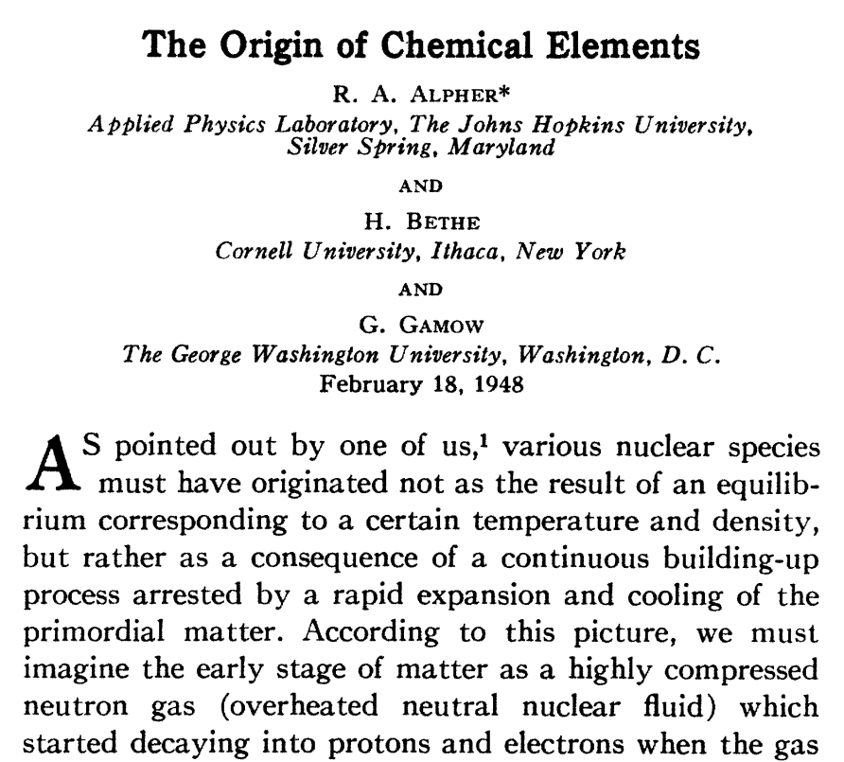
Pillar 2: Big Bang Nucleosynthesis (BBN)
The measured values of light-element abundances correspond very well with those predicted by theory (first published by G. Gamow et. al. in 1948)
Gamow, in an effort to be humorous, got Bethe to agree to lend his name to the authors…so Alpher, Bethe, Gamow!
http://www.itsokaytobesmart.com/post/25508554272/the-alpher-bethe-gamow-paper-who-says-scientists

Slide 25
Pillar 3: Cosmic Microwave Background (CMB)
Gamow, Alpher, and Robert Herman predicted the existence of the CMB around 1953. Arno Penzias and Robert Wilson detected the CMB in the spring of 1964.
Originally released at infrared wavelengths, the expansion of the universe has stretched the background wavelengths into the microwave region, hence the name. This matched well with the predicted values.
Spacecraft have measured tiny fluctuations in the CMB temp. due to early quantum fluctuations that led to uneven densities that eventually resulted in the formation of galaxies.

Slide 26
Space Based CMB maps of the universe
https://briankoberlein.com/2015/06/15/science-in-the-raw/

Slide 27
The Discovery of Dark Energy
Minute Physics Video

Slide 28
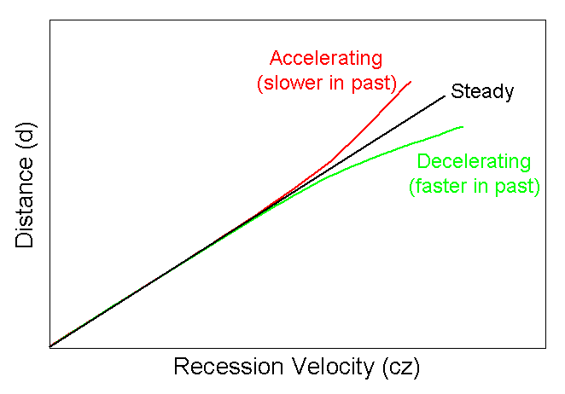
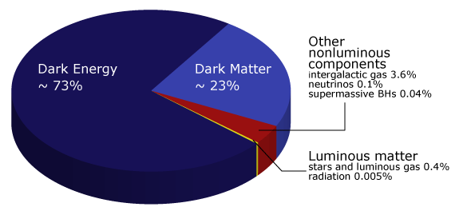
Dark Energy
In the 1990s astronomers were using Type Ia Supernova to measure distances to farther and farther galaxies.
They discovered the universe is expanding at an accelerating rate.
The unknown energy powering this expansion is now called dark energy. It makes up about 73% of all the energy/matter in the universe!
http://www.astronomy.ohio-state.edu/~thompson/1101/lecture_fate_of_universe.html
https://www.learner.org/courses/physics/unit/text.html?unit=11&secNum=6

