Slide 1
Relativity & Black Holes

Slide 2
Gravity’s Final Victory
Black Holes

Slide 3
Special Relativity
Light & Relativity
Consequences
Space-Time

Slide 4
Relativity & Light
Einstein’s Theory of Special Relativity (and every experimental test done) tells us the speed of light is the same, no matter the speed of the observer or source of light….
Now think about that…moving car, turns on headlights…people on the side of the road measure the same speed of light as the driver of the car!
http://www.oswego.edu/~kanbur/a100/lecture11.html

Slide 5
Relativity & Light
Einstein’s Theory of Special Relativity (and every experimental test done) tells us the speed of light is the same, no matter the speed of the observer or source of light….
Now think about that…moving car, turns on headlights…people on the side of the road measure the same speed of light as the driver of the car!
Furthermore, in his theory Einstein postulated that the laws of physics are the same in every “inertial” (constant speed and direction) reference frame.
The train engineer sees the people on the station platform moving and the people on the platform see the train moving…
Those are Einstein’s two postulates…and those led to some strange consequences…

Slide 6
Consequences of Special Relativity
If the speed of light is constant the distance and time must change!
As you approach the speed of light, time slows.
As you approach the speed of light, distance contracts.
As you approach the speed of light, mass (inertia) increases.

Slide 7
http://www.istianjinelearning.org/timeforphysics/2015/02/06/time-dilation/
http://philschatz.com/physics-book/contents/m42535.html
http://www.zamandayolculuk.com/html-1/lightclock_time.htm

Slide 8
Consequences of Special Relativity
Some short time after publishing his initial Special Relativity paper in 1905, Einstein published a follow-up showing that when you calculate an objects energy, even at zero speed, it’s equal to E=mc².
This has profound consequences for our understanding of the universe. Einstein’s famous equation tells us mass is another form of energy and it allowed astronomers to finally understand what powers the stars!
The stars convert some of their mass (via nuclear fusion) into energy (heat and light)!

Slide 9
Space-Time
Special Relativity has been tested many ways…ask me about a few…
One additional consequence of Special Relativity was that Einstein unified space and time into a single space-time. Space was wrapped up and connected with time in a very deep, fundamental way. He found that space-time was malleable and this led him toward a more general theory…
https://iai.tv/video/spacetime-and-the-structure-of-reality

Slide 10
General Relativity
Curved Space-Time
Tests

Slide 11
General Relativity
Einstein wanted to extend his theory. ”Special” Relativity was “special” because it only dealt with constant speed and direction. How would space-time behave when an object was accelerating?
He postulated that in a sealed container you couldn’t tell the difference between acceleration caused by gravity and acceleration caused by any other thing (like thrust in a spaceship).
If that’s the case….then….well let’s watch a clip from the Late Show…
Brian Greene Explains That Whole General Relativity Thing (~8 minutes)
https://youtu.be/0jjFjC30-4A

Slide 12
General Relativity
Curved space-time is the reason we ”feel” gravity. We are simple following the curvature of space that we are in…like a train on train track.
Matter tells space how to curve and
Space tells matter how to move!
Technically:
Matter (& energy) tells space (& time)
how to curve and space (& time) tells
matter ( & energy) how to move!
https://physics.stackexchange.com/questions/3009/how-exactly-does-curved-space-time-describe-the-force-of-gravity

Slide 13
Consequences of General Relativity
Light is bent by the curvature of space-time
Time slows in more curved space—the closer you get to a planet or star the slower time moves.
Ripples in space-time, also know as gravity waves, exist and carry energy.
Space-time can expand.
Black Holes can exist.
Details on the many tests of relativity are easily found on the internet and are a bonus question on Homework 6.
You might check out more of Brian Greene with this video: Gravitational Waves Hit the Late Show
https://www.youtube.com/watch?v=ajZojAwfEbs

Slide 14
Black Hole Properties
Schwarzschild Radius
Event Horizon
Singularity
Plunging into a Black Hole

Slide 15
Let’s watch
a clip from Brian Cox’s Wonders of the Universe: Falling…
Full documentary currently available at http://documentaryheaven.com/wonders-of-the-universe-3/
For the DVD…Disc 2, Episode Falling, Chapters 4 & 5 (20 min)
https://www.amazon.co.uk/Wonders-Universe-Brian-Cox/dp/0007395825

Slide 16
Homework Set 6
Due today…but let’s wait until the end of class to turn in….

Slide 17
Black Hole Anatomy
For stars that are very massive (at least 20 to 30 solar masses—although this number may be revised with further research), after they explode as supernovas they leave cores that are so massive that they shrink below the size of a neutron star and create a stellar mass black hole.
We are still not sure what minimum mass a star must have on the main sequence in order to collapse to form a singularity and black hole--a frontier of discovery in astronomy.

Slide 18
Singularity
Physicists and astronomers call the spot of infinite density at the center of a black hole a singularity.
To fully understand the nature of a black hole’s singularity requires still unknown laws of quantum gravity.
Something that has a quantum size but stellar mass is not currently understood—a frontier.
http://scienceblogs.com/startswithabang/2009/11/25/a-black-hole-without-a-singula/

Slide 19
The point of no return
The Schwarzschild radius of a black hole is the distance from the center to where the escape velocity of a black hole equals the speed of light.
$R_{s}=\frac{2GM}{c^{2}}$
For every solar mass, the Schwarzschild radius is about 3 km.
The sphere surrounding the black hole whose radius is the Schwarzschild radius is called the event horizon.
The event horizon is the point of no return. Inside that sphere the space is curved so much that even light will curve back to the center and not escape the sphere.

Slide 20
My niece and nephew (Sofie and Ozzy) would be ”over the moon” that I’m showing you a YuGiOh card. Is it YuGiOh?

Slide 21
Entering a Black Hole
The space-time distortion near a black hole is of course extreme.
As you get closer to the black hole:
Light is redshifted (towards longer wavelengths)
Time is dilated (flow of time slows—think of the movie Interstellar…)
Objects moving toward the black hole get pulled apart due the difference in curvature of the space on different ends or sides of the object—sphaghettified.

Slide 22
Entering a Black Hole
The space-time distortion near a black hole is of course extreme.
As you get closer to the black hole:
Light is redshifted (towards longer wavelengths)
Time is dilated (flow of time slows—think of the movie Interstellar…)
Objects moving toward the black hole get pulled apart due the difference in curvature of the space on different ends or sides of the object—sphaghettified.
Um, don’t try it.

Slide 23
Observing black holes
X-Rays
Supermassive Black Holes
Jets

Slide 24
https://www.nasa.gov/mission_pages/nustar/multimedia/pia15804.html

Slide 25
Cygnus x-1
Discovered in the 1970s, Cygnus X-1 is a strong source of X-Rays.
This object is now interpreted as being a stellar mass black hole that is “consuming” part of its binary companion.
As matter spirals toward the event horizon it moves faster and faster and heats up enough to emit X-Rays. As with planets forming around stars, the black hole has an accretion disk of in-falling matter surrounding it.
Before the discovery of gravitational waves in 2015-2016, these X-Ray binaries were some of the strongest evidence of black holes.

Slide 26
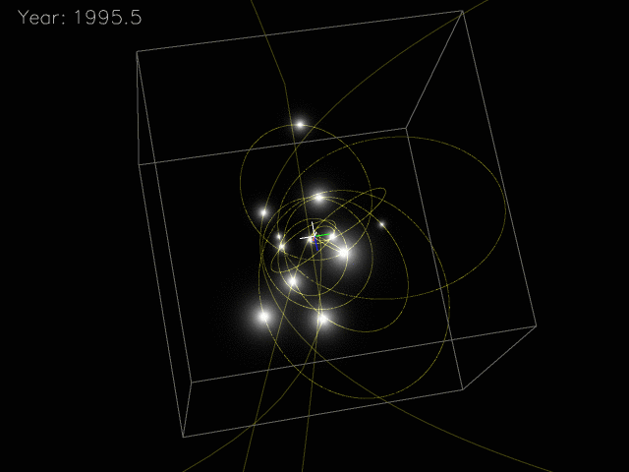
http://astro.uchicago.edu/cosmus/projects/UCLA_GCG/

Slide 27
http://www.constellation-guide.com/sagittarius-a/

Slide 28
Supermassive Black Holes
A bit earlier in the 1960s astronomer began discovering black holes at the centers of galaxies.
They are enormously massive objects –millions of solar masses--and are appropriately called supermassive black holes.
Stars orbiting the objects do so at incredibly high speeds and in some cases high energy light can be detected from their accretion disks.
The supermassive black hole in the center of the Milky Way is called: Sagittarius A*
Look for the “Teapot” this summer and you’ll be looking toward a supermassive black hole in the center of our galaxy!

Slide 29
Jets
Many black holes have been observed with jets of matter spewing out along the spin axis of the black hole.
Magnetic fields associated with the rapidly spinning accretion disks are though to be the origin of these jets.
In some cases the material is ejected at relativistic speeds—20-30% of the speed of light!
https://www.nasa.gov/topics/universe/features/radio-particle-jets.html

